Slide 1


Computer
Lecture 7
Dr. Nada Abdullah Rasheed
Assist prof. / Computer Science

Slide 2
Syllabus Content
Subject | Lec. No.
Components of the System Unit | 3
Case The Motherboard | 4
The Processor (CPU) | 5

Slide 3
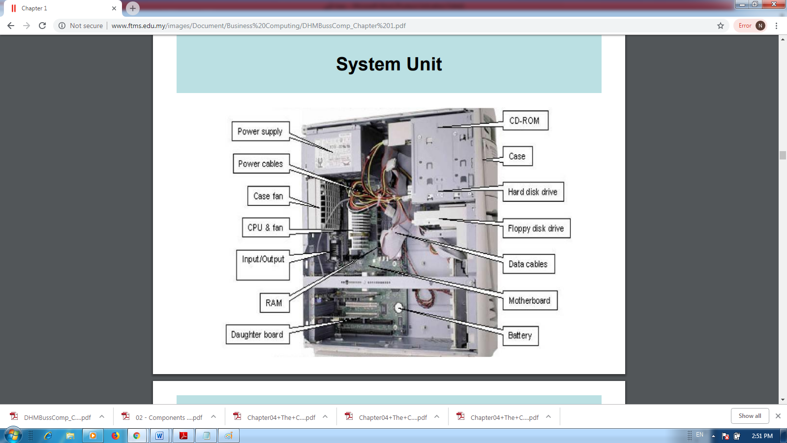
Components of the System Unit
The system unit is the core of a computer system.
The most important of these components is the central processing unit (CPU), or microprocessor and random access memory (RAM). Almost every other part of the computer connects to the system unit using cables. The cables plug into specific ports (openings), typically on the back of the system unit. Hardware that is not part of the system unit is sometimes called a peripheral device or device.

Slide 4
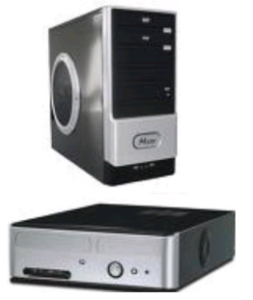
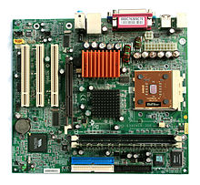
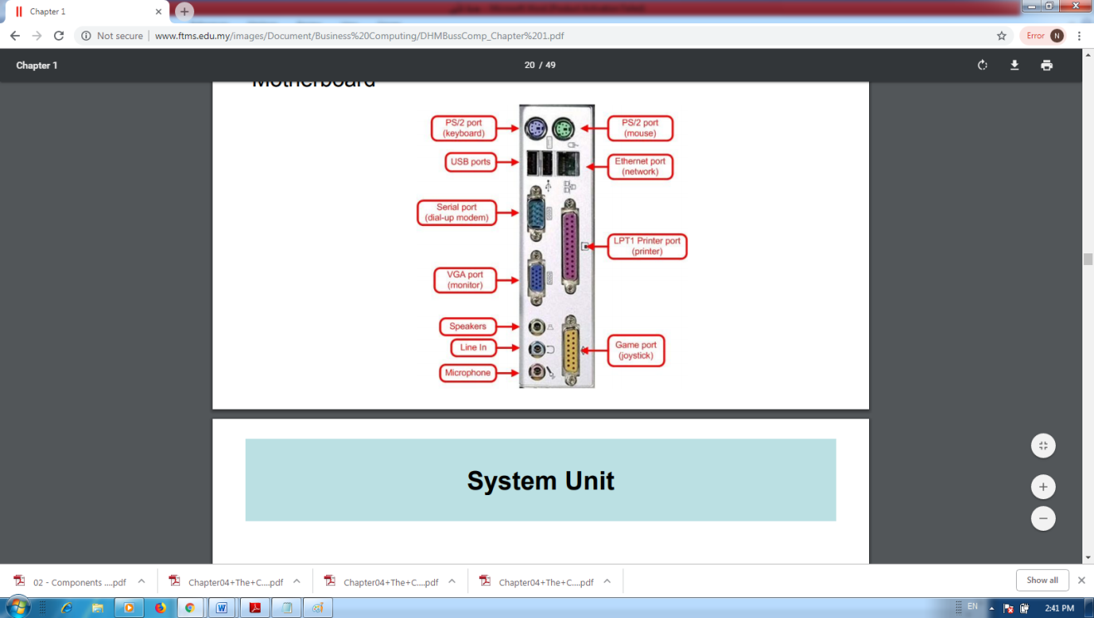
Case
• The case is the frame or chassis that houses the motherboard, power supply, disk drives, adapter cards, and any other physical components in the system.
The Motherboard
Often called the main board or system board, it is the main circuit board for the computer system. Every device in the computer system will either be part of the motherboard or connected to it.

Slide 5
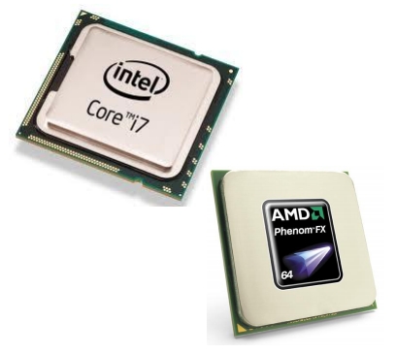
The Processor (CPU):
➢ The processor is often thought of as the "engine“ or “brain” of the computer.
➢ It's also called the CPU (central processing unit).
A processor is an integrated circuit (IC) supplied on a single silicon chip. All of the components and pathways necessary for the movement of data around the processor are etched on this single chip. The processor’s function is to control the activities of the computer system. A computer program is made up of instructions and when the program is run, the processor is responsible for carrying out these instructions in an orderly fashion. The type of instructions the processor can execute includes:

Slide 6
Arithmetic instructions - It carries out all the addition, subtraction, multiplication and division requested by computer programs.
Logical instructions - It can make decisions by comparing data and acting in a particular way depending on the result.
Move operations - It can move data from place to place within the computer system. This could be from memory to the processor for addition or from memory to a printer or disk drive etc.

Slide 7
The speed of a processor is measured in megahertz (MHz) or Gigahertz (GHz). The two main computer processor manufacturers are Intel and Advanced Micro Devices (AMD). These two companies produce almost all of the processors used in desktop and notebook computers. The latest trend in processor manufacture is to essentially put more than one processor on a silicon chip. These multi-core processors can have two, three or four processor cores on a single chip. This obviously vastly increases the performance of the computer system as long as the programs run on the systems can take advantage of the multi-cores.

Slide 8
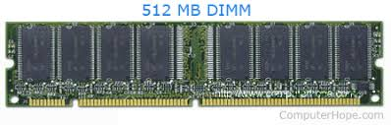
Memory
A memory is just like a human brain. It is used to store data and instructions. Computer memory is the storage space in the computer, where data are to be processed and instructions required for processing are stored. The memory is divided into a large number of small parts called cells. Each location or cell has a unique address, which varies from zero to memory size minus one. For example, if the computer has 64k words, then this memory unit has 64 * 1024=65536 memory locations. The address of these locations varies from 0 to 65535. Memory is primarily of three types: Cache Memory, Primary Memory/Main Memory and Secondary Memory.

Slide 9
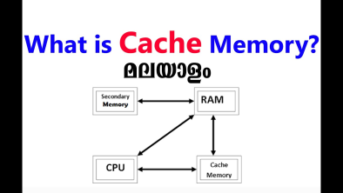
➢ Cache Memory
Cache memory is a very high speed semiconductor memory which can speed up the CPU. It acts as a buffer between the CPU and the main memory. It is used to hold those parts of data and program which are most frequently used by the CPU. The parts of data and programs are transferred from the disk to cache memory by the operating system, from where the CPU can access them.
Advantages: Cache memory is faster than main memory. It consumes less access time as compared to main memory. It stores the program that can be executed within a short period of time. It stores data for temporary use.
Disadvantages: Cache memory has limited capacity. It is very expensive.

